Slide 1
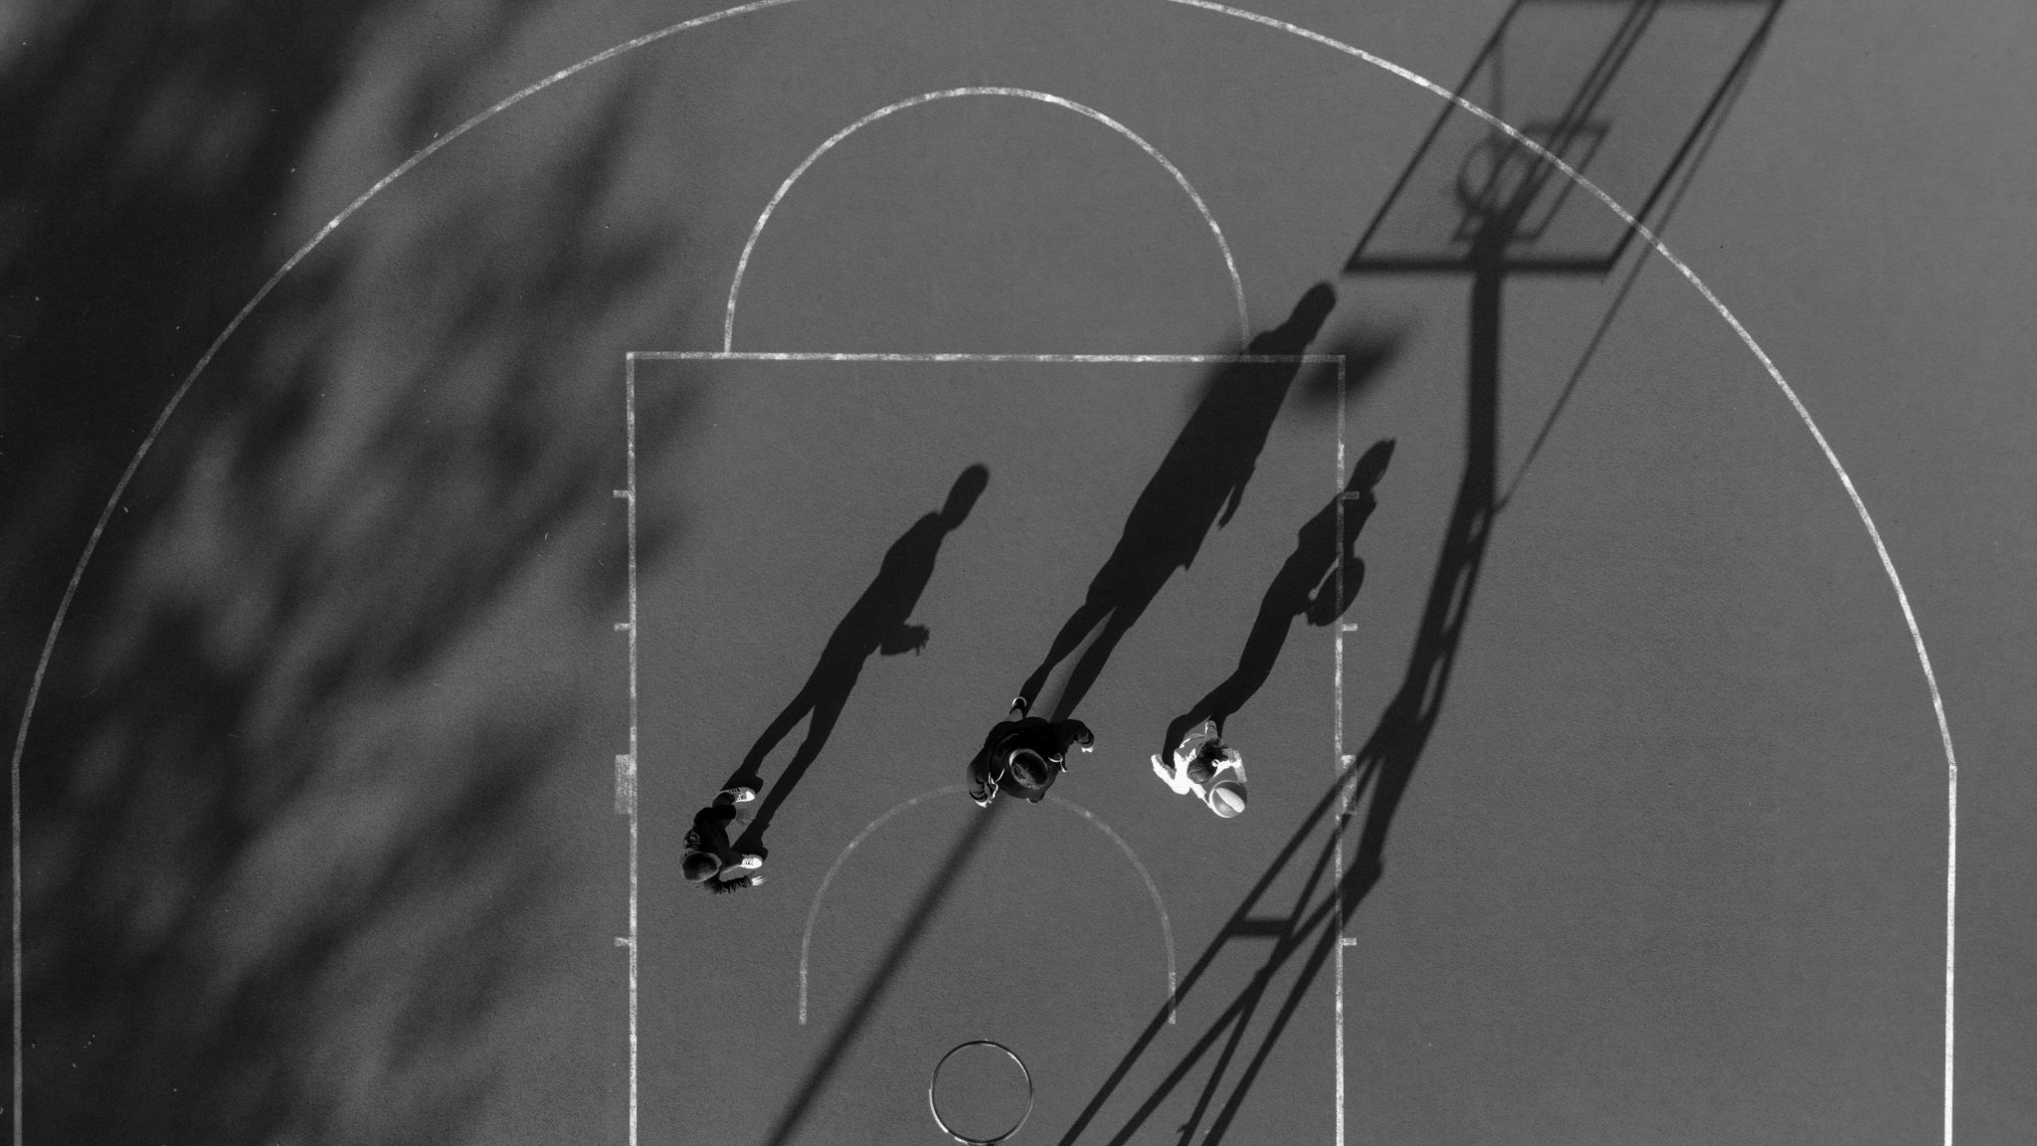
Dynamic Warm-Up and Its Relationship With Performance and Injury Prevention
10/16/26
Garrett Duffin, DPT
Rocky Mountain College MBB
AMP Sideline Coaches Clinic

Slide 2
Objectives
Understand difference between dynamic warm-up vs static stretching
Know relationship between dynamic warm-up, performance, and injury prevention
Define all phases of a dynamic warm-up knowing why and how we do them
Learn how to build and implement comprehensive, structured dynamic warm-up
Actively participate in Rocky Mountain College Men’s Basketball dynamic warm-up

Slide 3

Dynamic
Repeated, controlled movements
Increases heart rate and blood flow
Prepares neuromuscular system
Enhances performance and movement
Static
Maintained lengthen muscle position
Increases flexibility
Inhibits neuromuscular system
Reduces force/power output

Slide 4
Injury Prevention
Systematic Review
  35-39% injury risk reduction in youth soccer
Structured neuromuscular warm-up
  Strength
  Balance
  Landing control
  Sport-specific movement practice
Repeated practice = movement control
Exposed to positions in controlled setting prior to uncontrolled live competition
Performance
Transition from rest to:
  Faster movement
  More forceful movement
  Better coordinated movement
Increases blood flow and muscle temp
Prepares muscles through joint ranges of motion
Rehearses coordination & sport-specific movement patterns
Progressively brings speed and explosiveness closer to the demands of the sport

Slide 5
Phases of Dynamic Warm-up
General Warm-up
Dynamic Mobility & Activation
Movement Preparation & Motor Control
Potentiation & Agility

Slide 6
General Warm-up
Why
Increase heart rate
Boost blood flow
Raise muscle temperature
How
Rocky Mountain MBB
  Line Hops
  Jog
  Backpedal
Other Examples
  Jump Rope
  Cycle

Slide 7
Dynamic Mobility
Dynamic Mobility & Activation
Why
Mobilize joints and working muscle
Move through controlled, active motion
Engage key stabilizers
How
Rocky Mountain MBB
  Open/Close Gait
  Cradle to Lateral Lunge
  Hamstring Scoop
  High Kicks
  Knee Hug to Lunge
  Quad Pull to Reverse Lunge
  Toe/Heel Walk
  Squats (Bilateral and Single Leg)
  Hinges (Bilateral and Single Leg)

Slide 8
Dynamic Mobility
Movement Prep & Motor Control
Why
Rehearse coordination
Initiate required force production
How
Rocky Mountain MBB
  Carioca
  Shuffle with Arm Swing
  High Knee
  Butt Kick
  Lateral High Knee
  Skips

Slide 9
Dynamic Mobility
Potentiation & Agility
Why
Increase intensity of activity-specific movements
Prepare body for the speed, force, and power required for competition
How
Rocky Mountain MBB
  Squat Jumps
  Pogos
  Linear Acceleration/Deceleration
  Diagonal Acceleration/Deceleration
  Tuck Jumps to Sprint
  Shuffle to Sprint

Slide 10
Your Turn!

