Slide 1

The Student-Athlete Experience
Dr. Danny Desin, CMPC

Slide 2
Who am I and what is Mental Performance?
Former college athlete
Golf’s Sacred Journey: Seven Days in Utopia
  Dr. David Cook (peak performance consultant)
M.S. in Psychology-Sport Psychology (2018)
Ed.D. in Sport and Performance Psychology (2021)
Association for Applied Sport Psychology
  Certified Mental Performance Consultant (CMPC) - 2019, 2024
USOPC Sport Psychology Registry

Slide 3
Mental Performance/Mental Skills
Why focus on the mental part of the game?
Performance = Potential - Interference
The mental game allows individuals to limit interference, perform at the highest level possible.

Slide 4
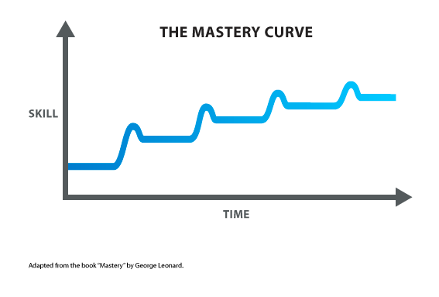

Slide 5
Stages of Mental Skills Training
Education
Acquisition
Practice
Mental Skills take Time and Effort

Slide 6
Sport Psychology
Using mental skills training to:
  Strive for peak performance
  Increase well-being related to sport participation
  Influence others beyond the individual or team
Team and individual levels (who I’m working with)
Multiple reactions
  “That exists?”
  “That’s cool, not sure how it would fit”
    Voodoo, psychobabble, motivational speaking, etc.
  “This is a need”

Slide 7
Sport Psychology/Mental Performance and Mental Health
“Inside the lines” vs. “outside the lines”
Where are the lines? Are they clearly defined?
  Clinical vs. Non-clinical
Sport psychology as prevention
  Burnout
  Youth athletes: Teaching through sport

Slide 8
Mental Skills
Goal Setting
  Process vs Outcome Goals
Strengths, Athletic Identity, and Passion
Mental Toughness and Composure (in recovery)
Mental Rehearsal (aka visualization)
JOURNAL
  Self Aware vs. Self Conscious

Slide 9
The Student-Athlete Experience
While mental skills are important, they cannot stand on their own.
Many situations in sport go much deeper than physical or mental skills.

Slide 10
Athletic Identity
The degree of strength and exclusivity to which a person identifies with the athlete role or the degree to which one devotes special attention to sport relative to other engagements or activities in life.

Slide 11
Passion for Sport
Not an undisputed fact, but most high-level athletes have developed passion for their activity over time.
  A strong inclination toward an activity that one likes, finds important, invests time and energy
  When an individual develops passion for an activity, it becomes part of their identity.

Slide 12
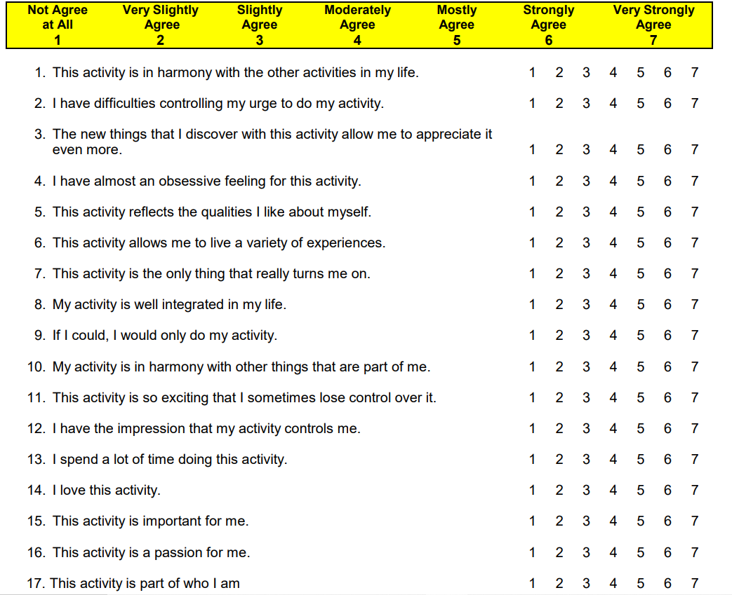

Slide 13
Obsessive Passion
Athletes become controlled by the activity and sacrifice other activities for that reason.
  Social, academic.
Internalized by attaching value to participation.
Tied to higher levels of burnout.

Slide 14
Harmonious Passion
Activity becomes an important, but not overwhelming part of an athlete’s life.
Internalized the right way with no contingencies, value attached.
Tied to positive emotion, well-being, performance, resilience, and coping skills.

Slide 15
The Role of Sport
Sport was not created to increase pressure on young athletes
  Pressure and performance anxiety.
  They sometimes don’t enjoy their sport anymore, want to quit.
Sport should always be an escape, a place to take risks and push yourself without the guarantee of success.
  Man in the Arena
When did we lose grip on the role of identity in sport? Why is the purpose for play not talked about?
  Student-athletes are citing their sport as reasoning for a mental health concern

Slide 16
Common Issues/Mental Obstacles
Perfectionism (adaptive vs. maladaptive)
Comparison to peers
Fixation on the Outcome
Role confusion
Athletic Identity too high – Obsessive Passion
External pressures (some that we don’t see)
Negative outcomes: Burnout, Anxiety, Quitting

Slide 17
Solutions
Influence a Process Orientation
  Journal
  Goal-setting
  Coaching emphasis
Provide Role Clarity
  One minute conversations (or more)
  Clearly define
  VIA Character Survey (viacharacter.org)
Talk about Purpose and Perspective

Slide 18
Purpose and Perspective
Healthy Athletic Identity and Harmonious Passion are influenced by a healthy perspective and a clear purpose for playing.
The right messages at the right time will prevent burnout, negative relationships with the game, and possibly mental health concerns directly related to sport.
Why do you play? What is your sport doing for you? What are you doing through your sport?
Why do you coach? What is coaching doing for you? What are you doing through coaching?
Who are your athletes playing for?

Slide 19

THANK YOU!!
ddesin@mtpeakperformance.com
(406) 794-2048
mtpeakperformance.com

