Slide 1

Neurodiverse Athlete and Inclusion in Athletics
Brooke Hollowell, M.S. CCC-SLP

Slide 2

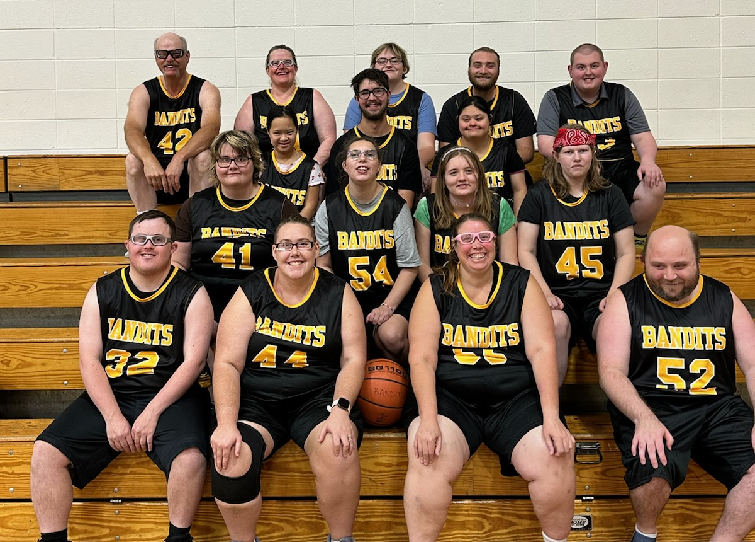
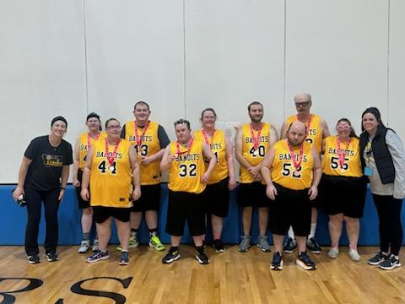
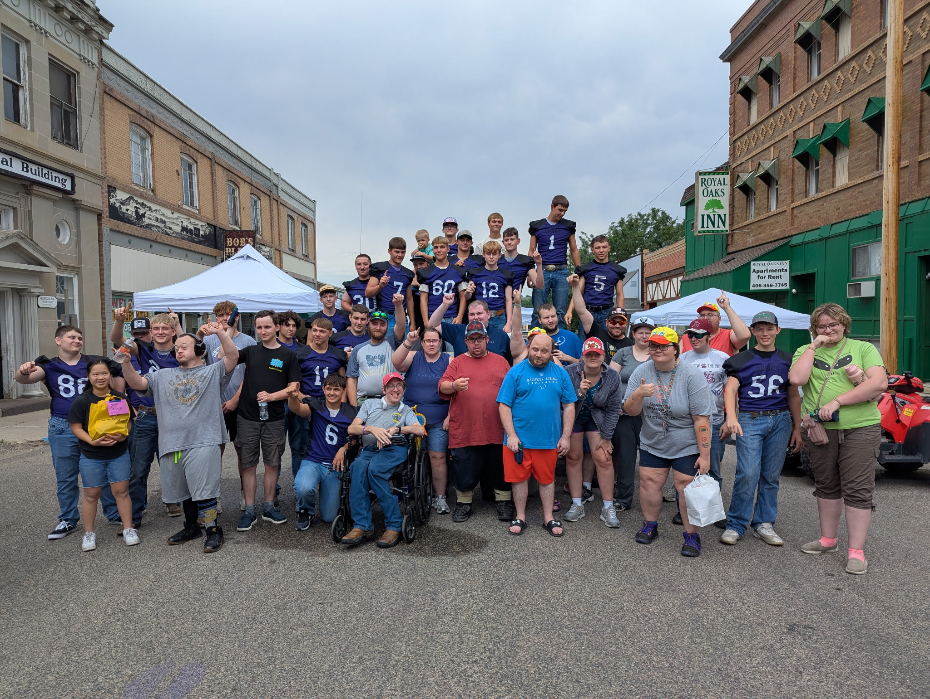
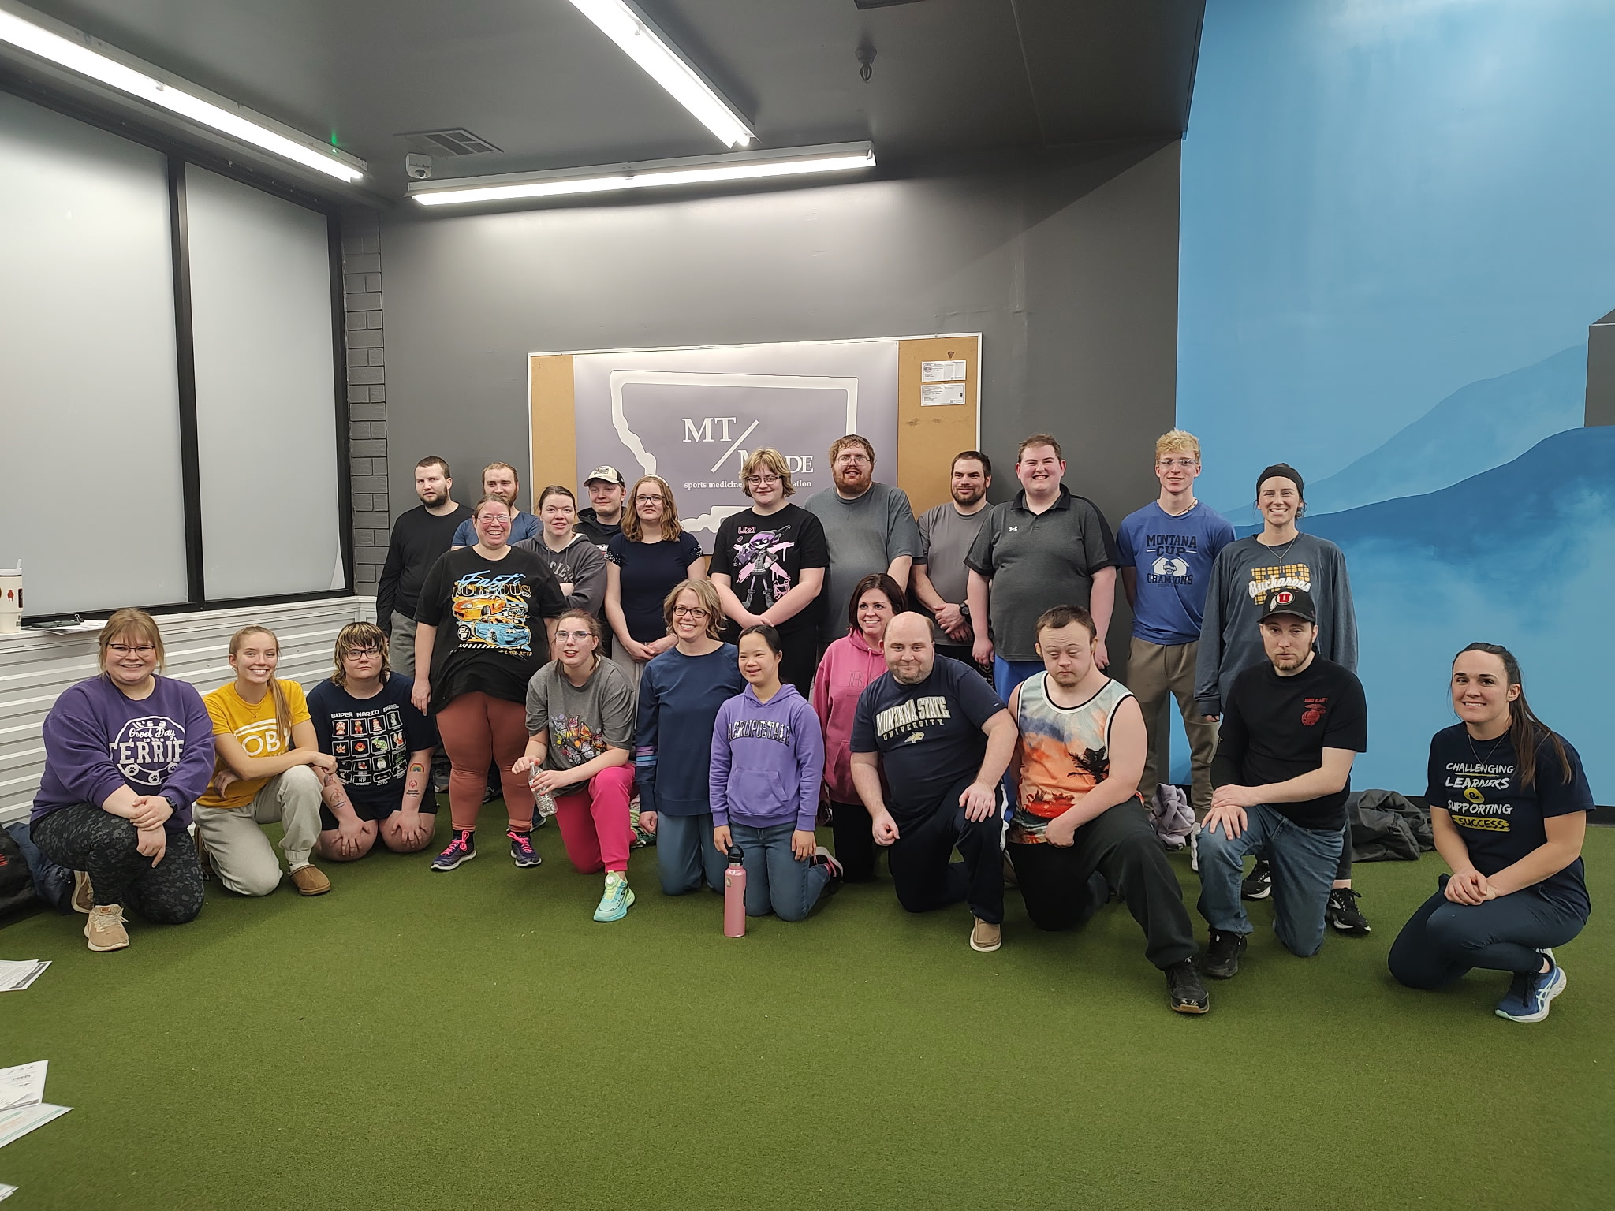
Background
Masters of Science from University of Montana for Speech Language Pathology
Experience with coaching during college opportunities for youth and special needs individuals
Referee for intramural and club programs, MOA volleyball referee for 2020-2021 year
Current independent contractor working with school districts, collaborate with other therapists, school staff, behavior teams
Contractor for DEAP (Developmental Educational Assistance Program) for ADOS testing (Autism)
Head coach and LPC for Miles City Bandits Special Olympics program

Slide 3
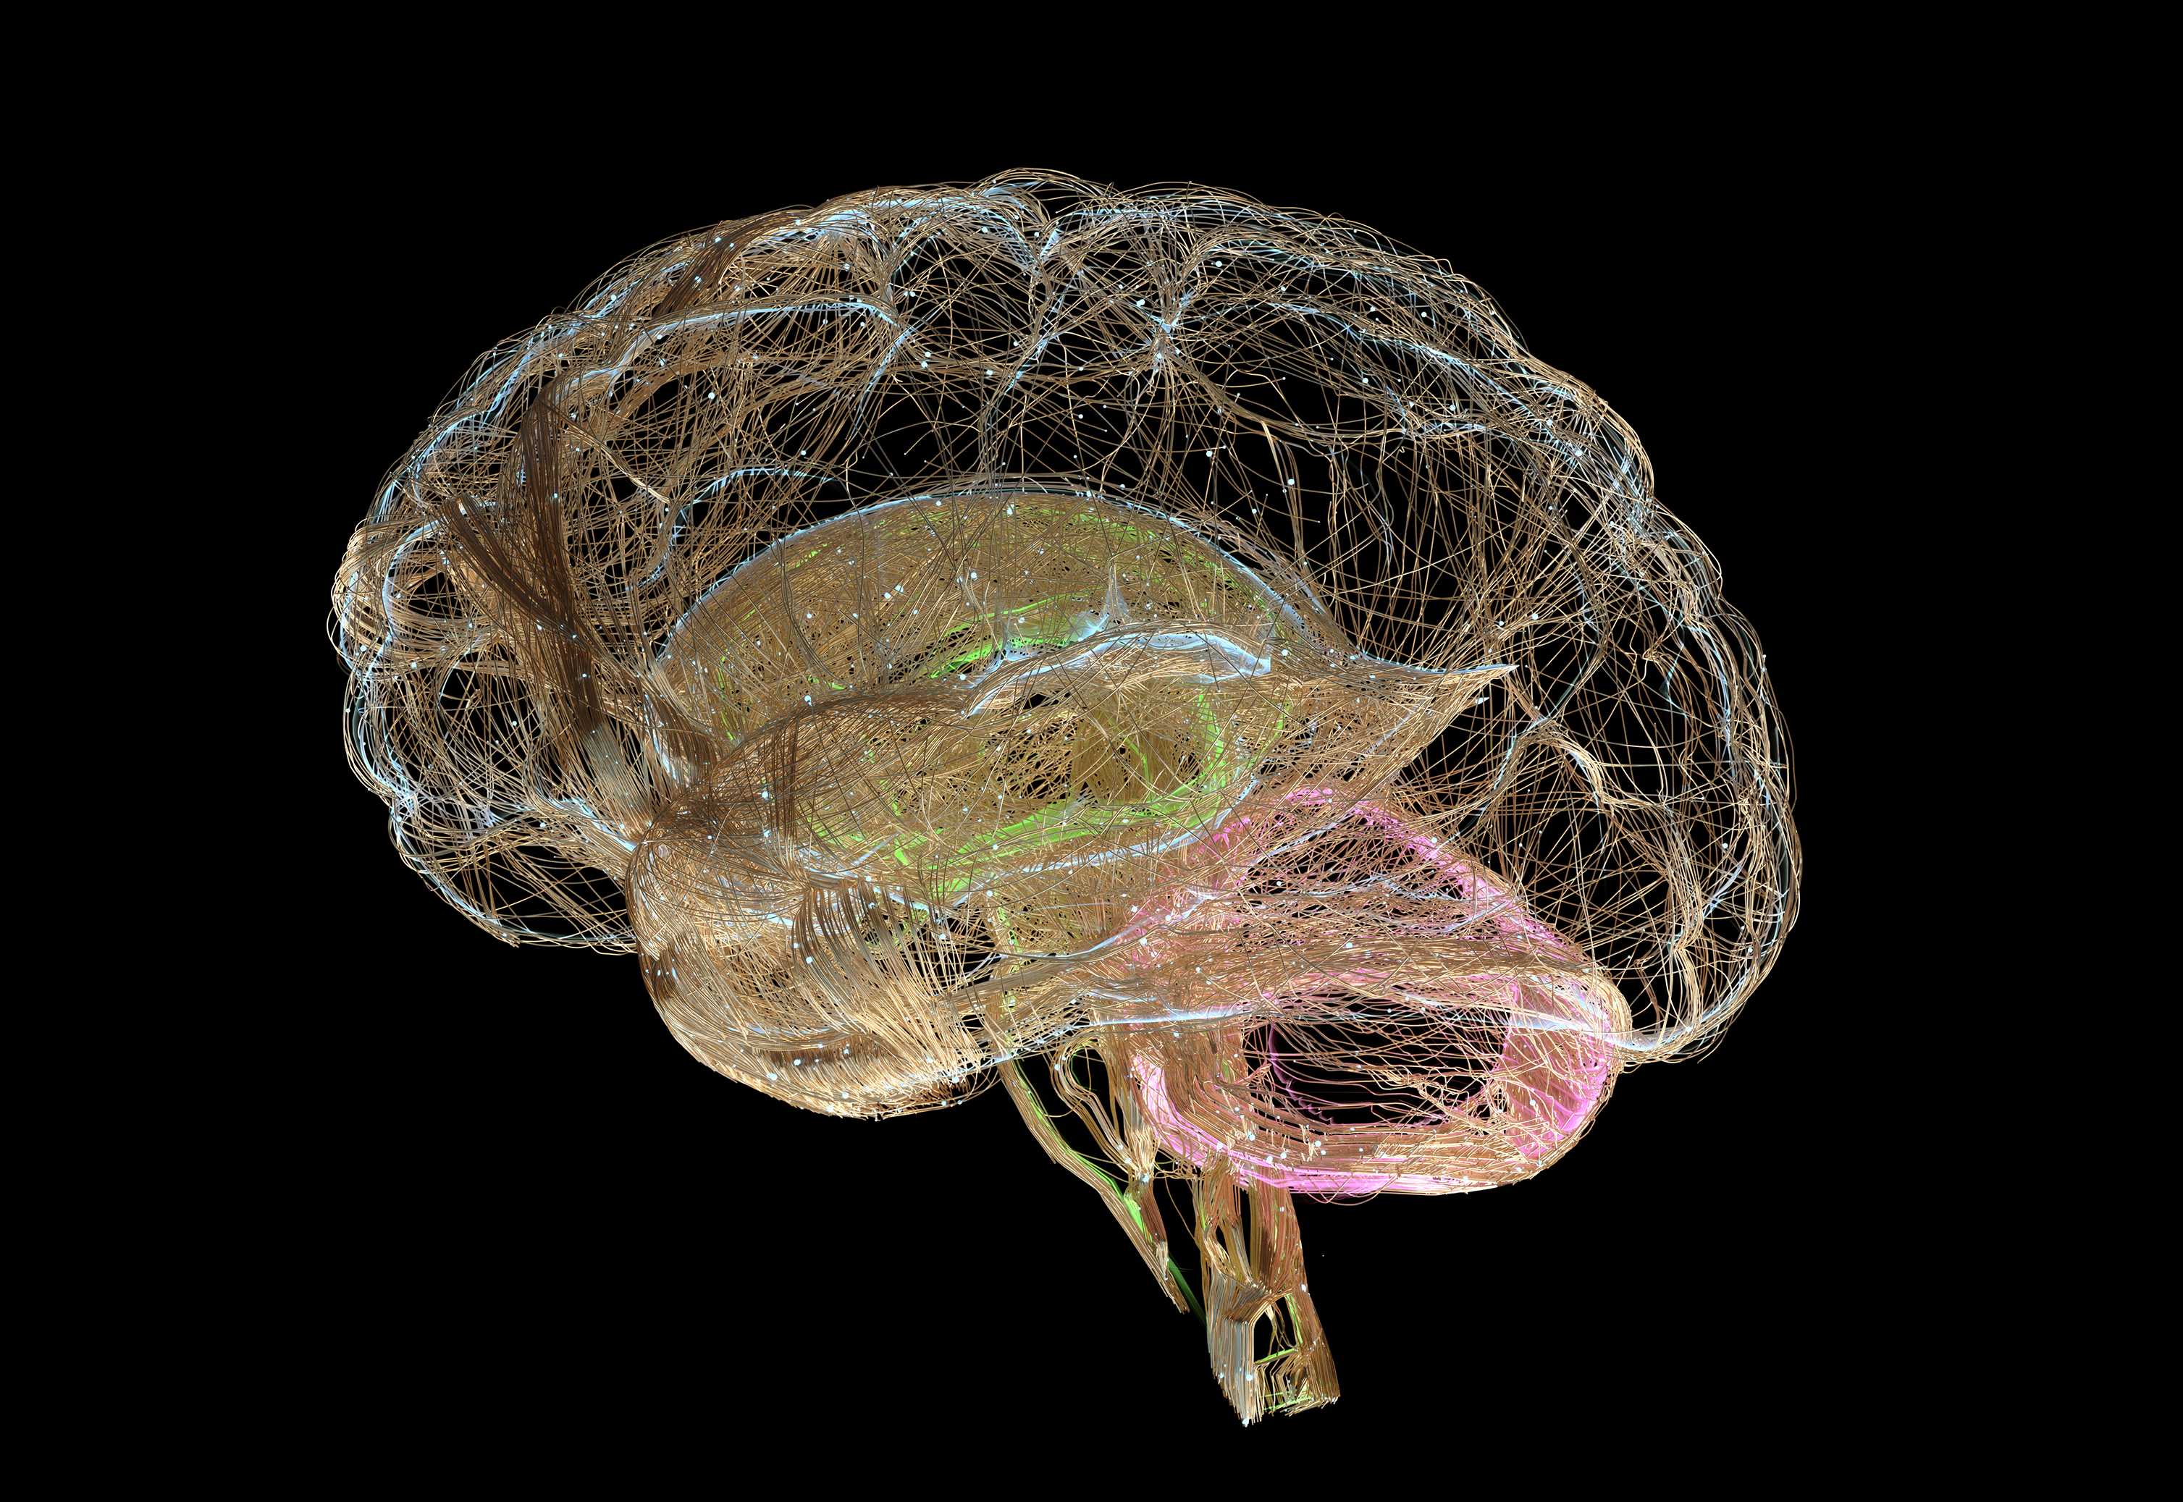
Neurodiversity, what is it?
Neurodiversity describes the idea that people experience and interact with the world around them in many ways and that there is no one right way of thinking and learning.
Typically used in the context of autism spectrum disorder (ASD), ADHD, dyslexia, Tourette syndrome, obsessive-compulsive disorder, bipolar disorder, schizophrenia, intellectual disabilities, or other learning disabilities
Neurodivergence is not a diagnosis or a disability but a social theory that recognizes and celebrate the diversity of the human brain.

Slide 4
Numbers Perspective
1 in 31 children are diagnosed with Autism Spectrum Disorder
In a typical classroom, 1 of 9 students have a history of ADHD

Slide 5
Levels of Autism
Level 3: Requiring Very Substantial Support
Severe communication deficits (possibly non-speaking or echo only)
Repetitive behaviors like rocking/spinning
Extreme distress with transitions
May need 1:1 time, may use an augmentative and alternative communication device (AAC)
Behaviors interfere with daily functioning
Level 1: Requiring Support
Trouble understanding and following social rules
Rigid or inflexible behavior
Some stress during transitions
May benefit from therapy or life skills coaching
Level 2: Requiring Substantial Support
Atypical social behavior, like walking away mid-conversation
High Interest in specific topics
Noticeable distress when faced with change
May need school accommodations/social skills support

Slide 6
Observations/Traits of Neurodiverse Athletes
Appear non-responsive to outside stimuli or demonstrate unusual responses to sensory experiences (hearing a whistle, seeing lights on the score board, not liking the grass on a field, etc.)
Engage in repetitive activity
Resist change in the routine or structure of practice/limited flexibility
Exhibit self-stimulatory behaviors, such as hand flapping, rocking, sensory needs
May not initiate conversation with peers or adults/avoid participation
Difficulty in selecting appropriate responses

Slide 7
Supports
Dim the lights in a gym if possible, during gym time
Repetition and reinforcement
Break down tasks to improve completion (scaffolding, break large concepts into small pieces and sequence in ways that generate success)
Allow sensory breaks/choices
If communication is limited, use of gestures (thumbs up, high five, break sign)
Be clear, concreate, concise, and consistent
Make sure an athlete/student is looking at you and can hear you when communicating
Short attention spans, ensure eye contact, have the athlete/student repeat the task
Clear expectations for practice/training
Make transitions known, prepping with time, visuals, verbal's when needed
All behavior serves as a function, find a replacement behavior (ask school staff if a behavior plan is in place)

Slide 8

Case Study
Student athlete on track and field team
Verbal but rigid communication
Avoids social situations with teammates
Over-stimulated with changes in schedule
Load noise and crowds are overwhelming
Excels in long distance running
Strategies to support
Visuals of schedule of events
Time to take breaks between events without peers around/independent
Encourage a peer as a buddy with warming up, maybe not in big group
Ability to wear headphones/accommodation

Slide 9
Your Turn, Let’s Brainstorm
Examples in your setting
(classroom, extracurricular, or team)

Slide 10
References
Gene, D. (2023, July 31). Understanding Neurodivergence: A Guide for Parents - LDRFA. LDRFA. https://www.ldrfa.org/understanding-neurodivergence-guide-for-parents/
MEd, N. B. M. (2021, November 23). What is neurodiversity? Harvard Health. https://www.health.harvard.edu/blog/what-is-neurodiversity-202111232645
Millett, M., Linda Costello-Roth, John Ford, Ilima Kane, & Rebecca Shangraw. (2013). Special Olympics Athlete-Centered Coaching Guide. In Special Olympics Athlete-Centered Coaching Guidehttps://media.specialolympics.org/resources/sports essentials/general/AthleteCentered_CoachingGuide.pdf
NEURODIVERSE SPORT. (2025, September 1). Neurodiverse Sport. https://neurodiverse-sport.squarespace.com/

